Slide 1
ProductsController.php
POST::https://domineo.com/products
VISTA
(HTML)
Create (Request $products)
{ guardar los productos en el REPOSITORIE }
Route.php
[“protocolo” =? ”POST”, “route” =? ”products”]
Mediante la URL le estoy enviando a mi controlador (Request $products)
ProductModelEloquent.php
MAPEO
DB
MySql
Eloquent <=> Mysql
Products

Slide 2
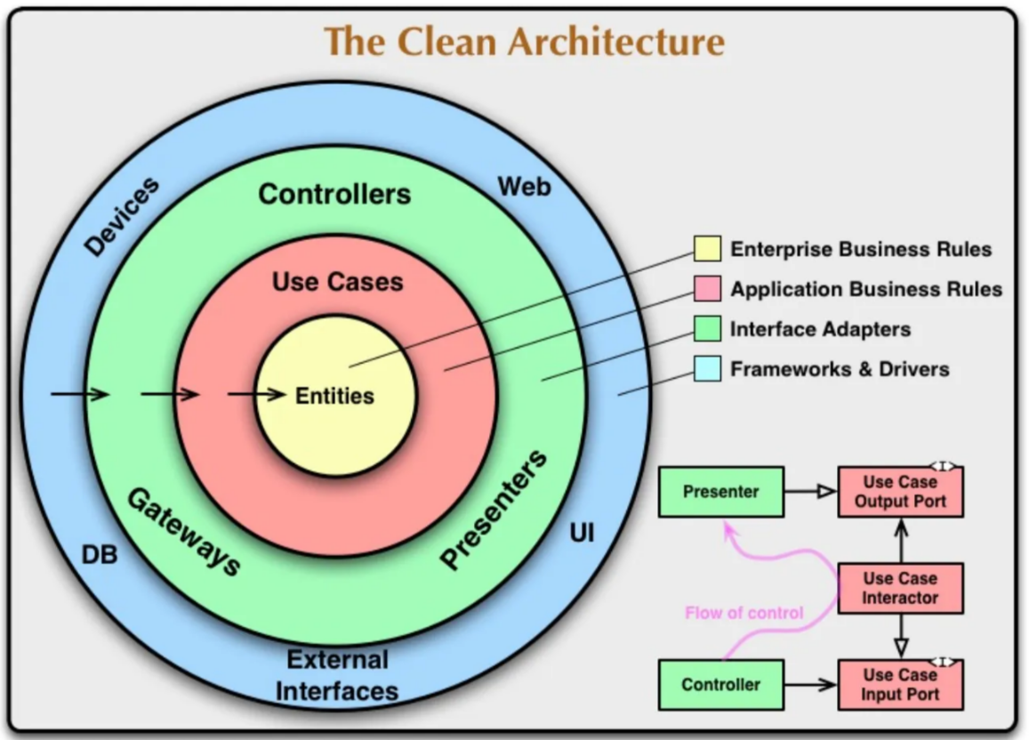
POST::https://domineo.com/products
Vista (HTML)
Mediante la URL le estoy enviando a mi controlador (Request $products)
Route.php
PruductController.php
[“protocolo” =? ”POST”, “route” =? ”products”]
Create(Request $products)
{ guardarlos en el repositorio}
LARAVEL
LOGICA DEL SISTEMA
App/Aplication/Product
Execute create
CreateProductCaseUse.php
App/Models
Presenter
PoductModelEloquet.php
ProductRepositoryInterface.php
App/Infrastructure/Persistence/Eloquent
Repositories
EloquentProducRepository.php
create(Product $product): Product
Mysql
Repository
products
App/Domain/Product/
ProductModelEntitie.php
LOGICA DEL NEGOCIO
Entities

